Slide 1
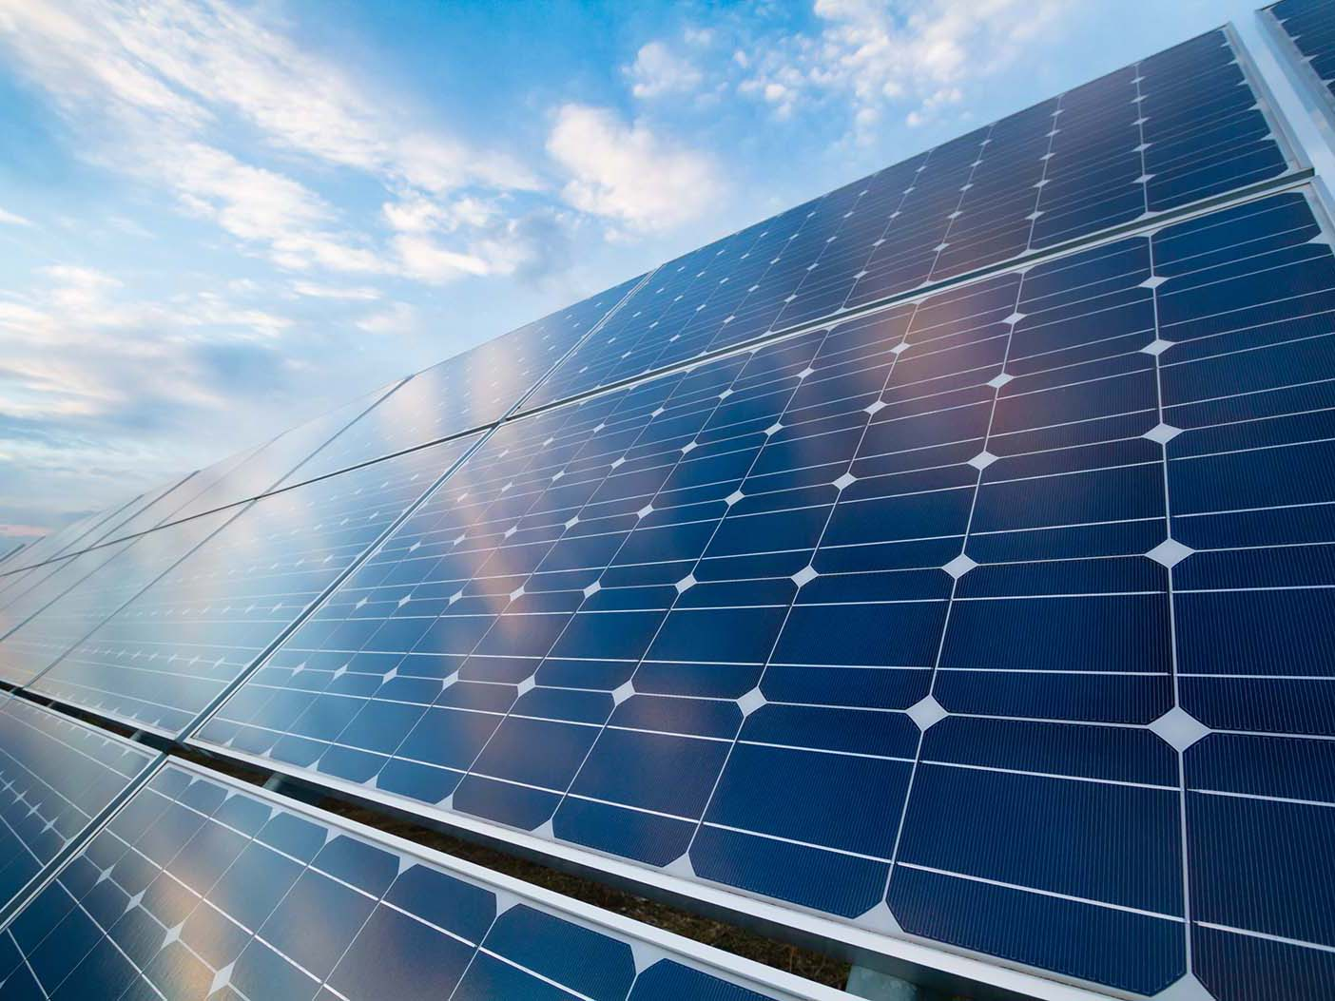

ECEN 404 Final Presentation
Team 16: Solar Power Battery Lauren Lugo, Tarik Dawson, Clement Ong, Nathan Gil Sponsor: Peng-Hao Huang TA: Dalton W. Cyr
Notes:
Michelle

Slide 2
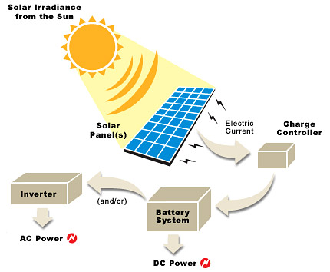
Project Summary
Problem Statement:
Provide the user with an independent solar power generating system that can charge both AC and DC devices
Solution proposal:
Develop independent power grid using a solar panel that can charge the majority of items throughout the day and night. Both AC and DC power provided.
Notes:
Kyle

Slide 3
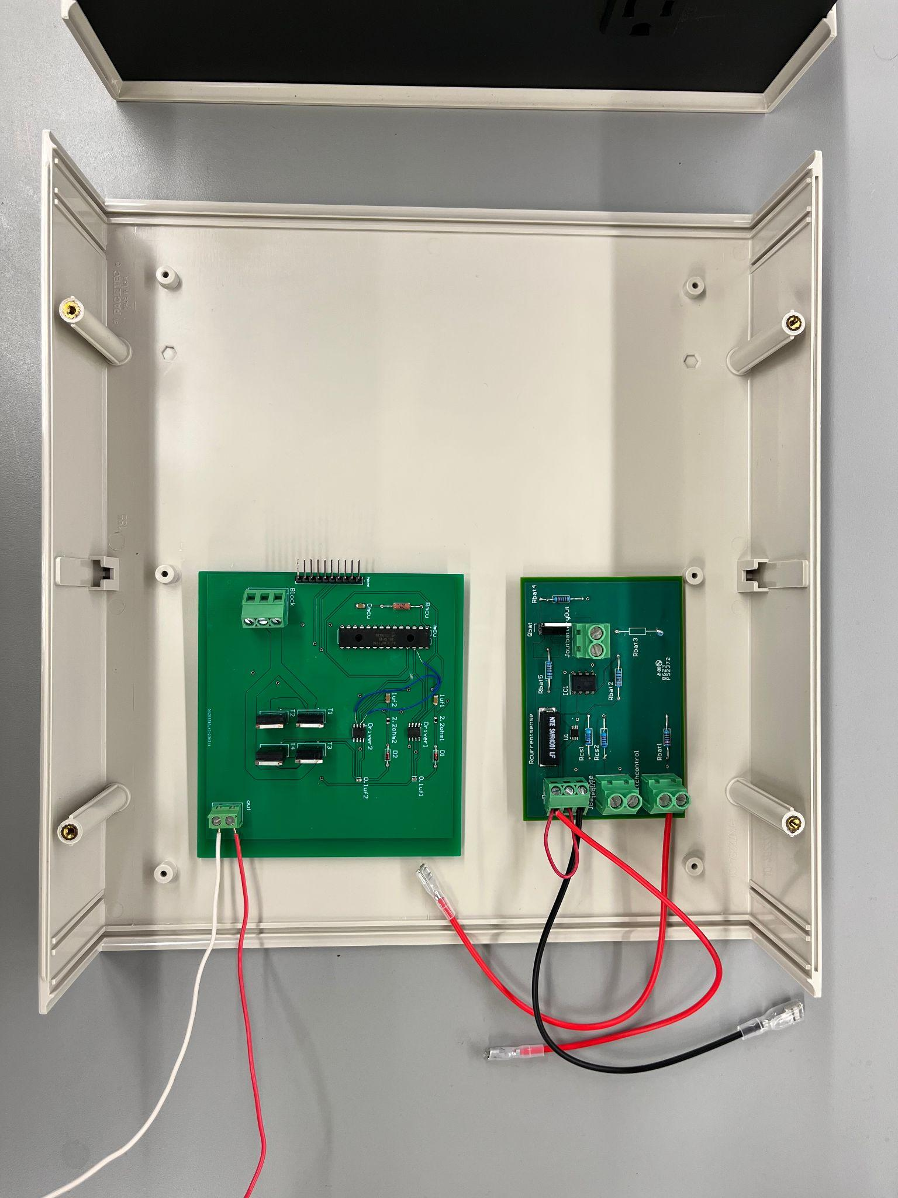
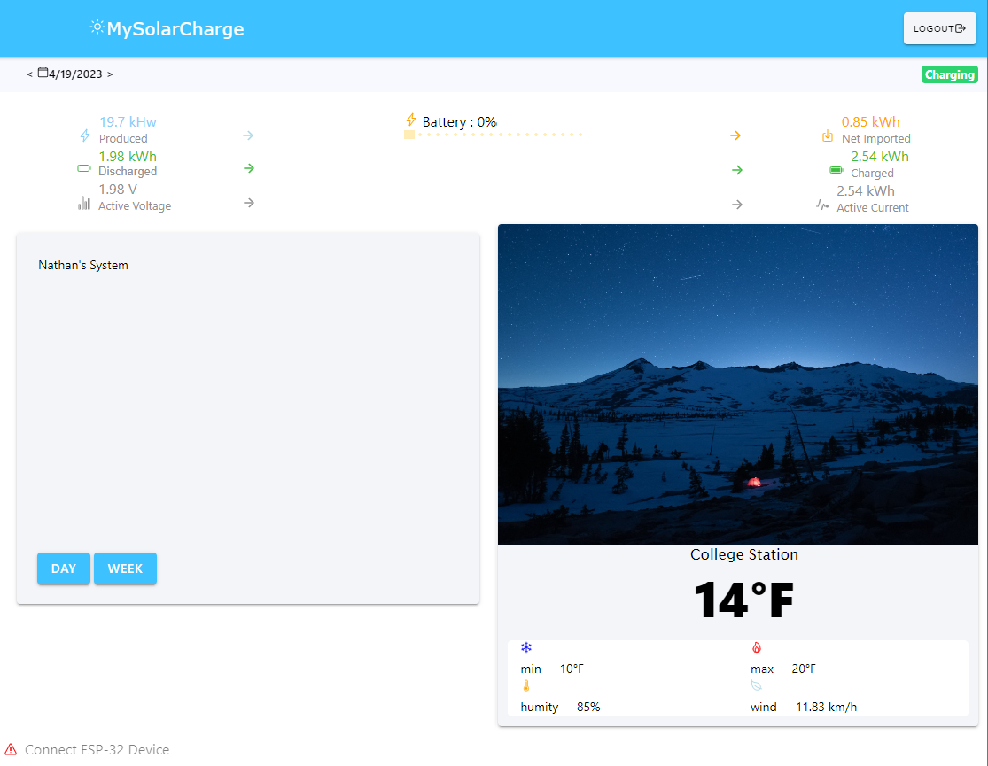
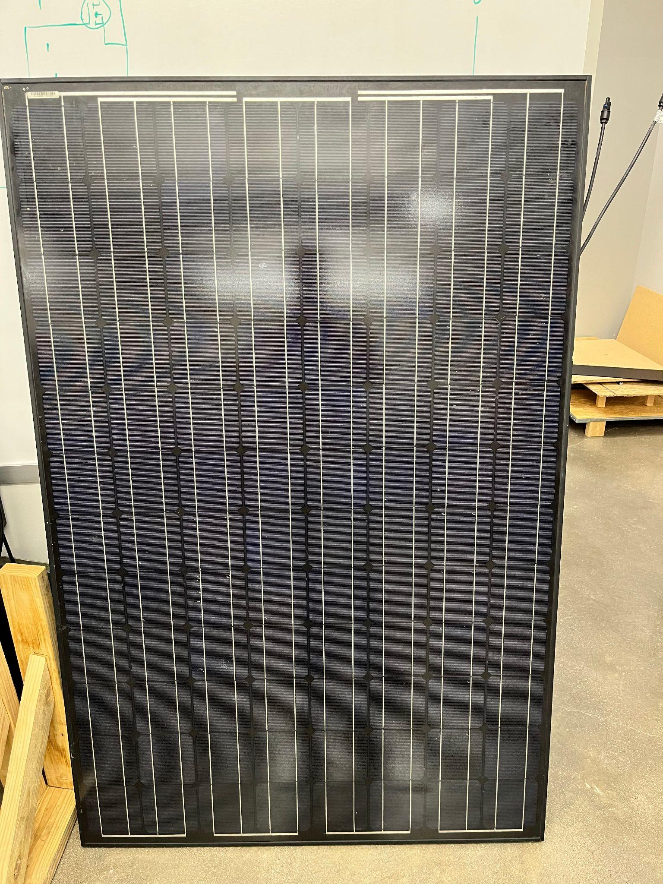
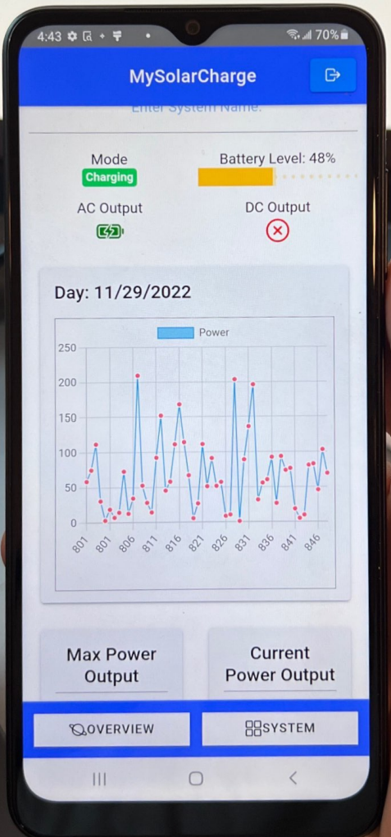
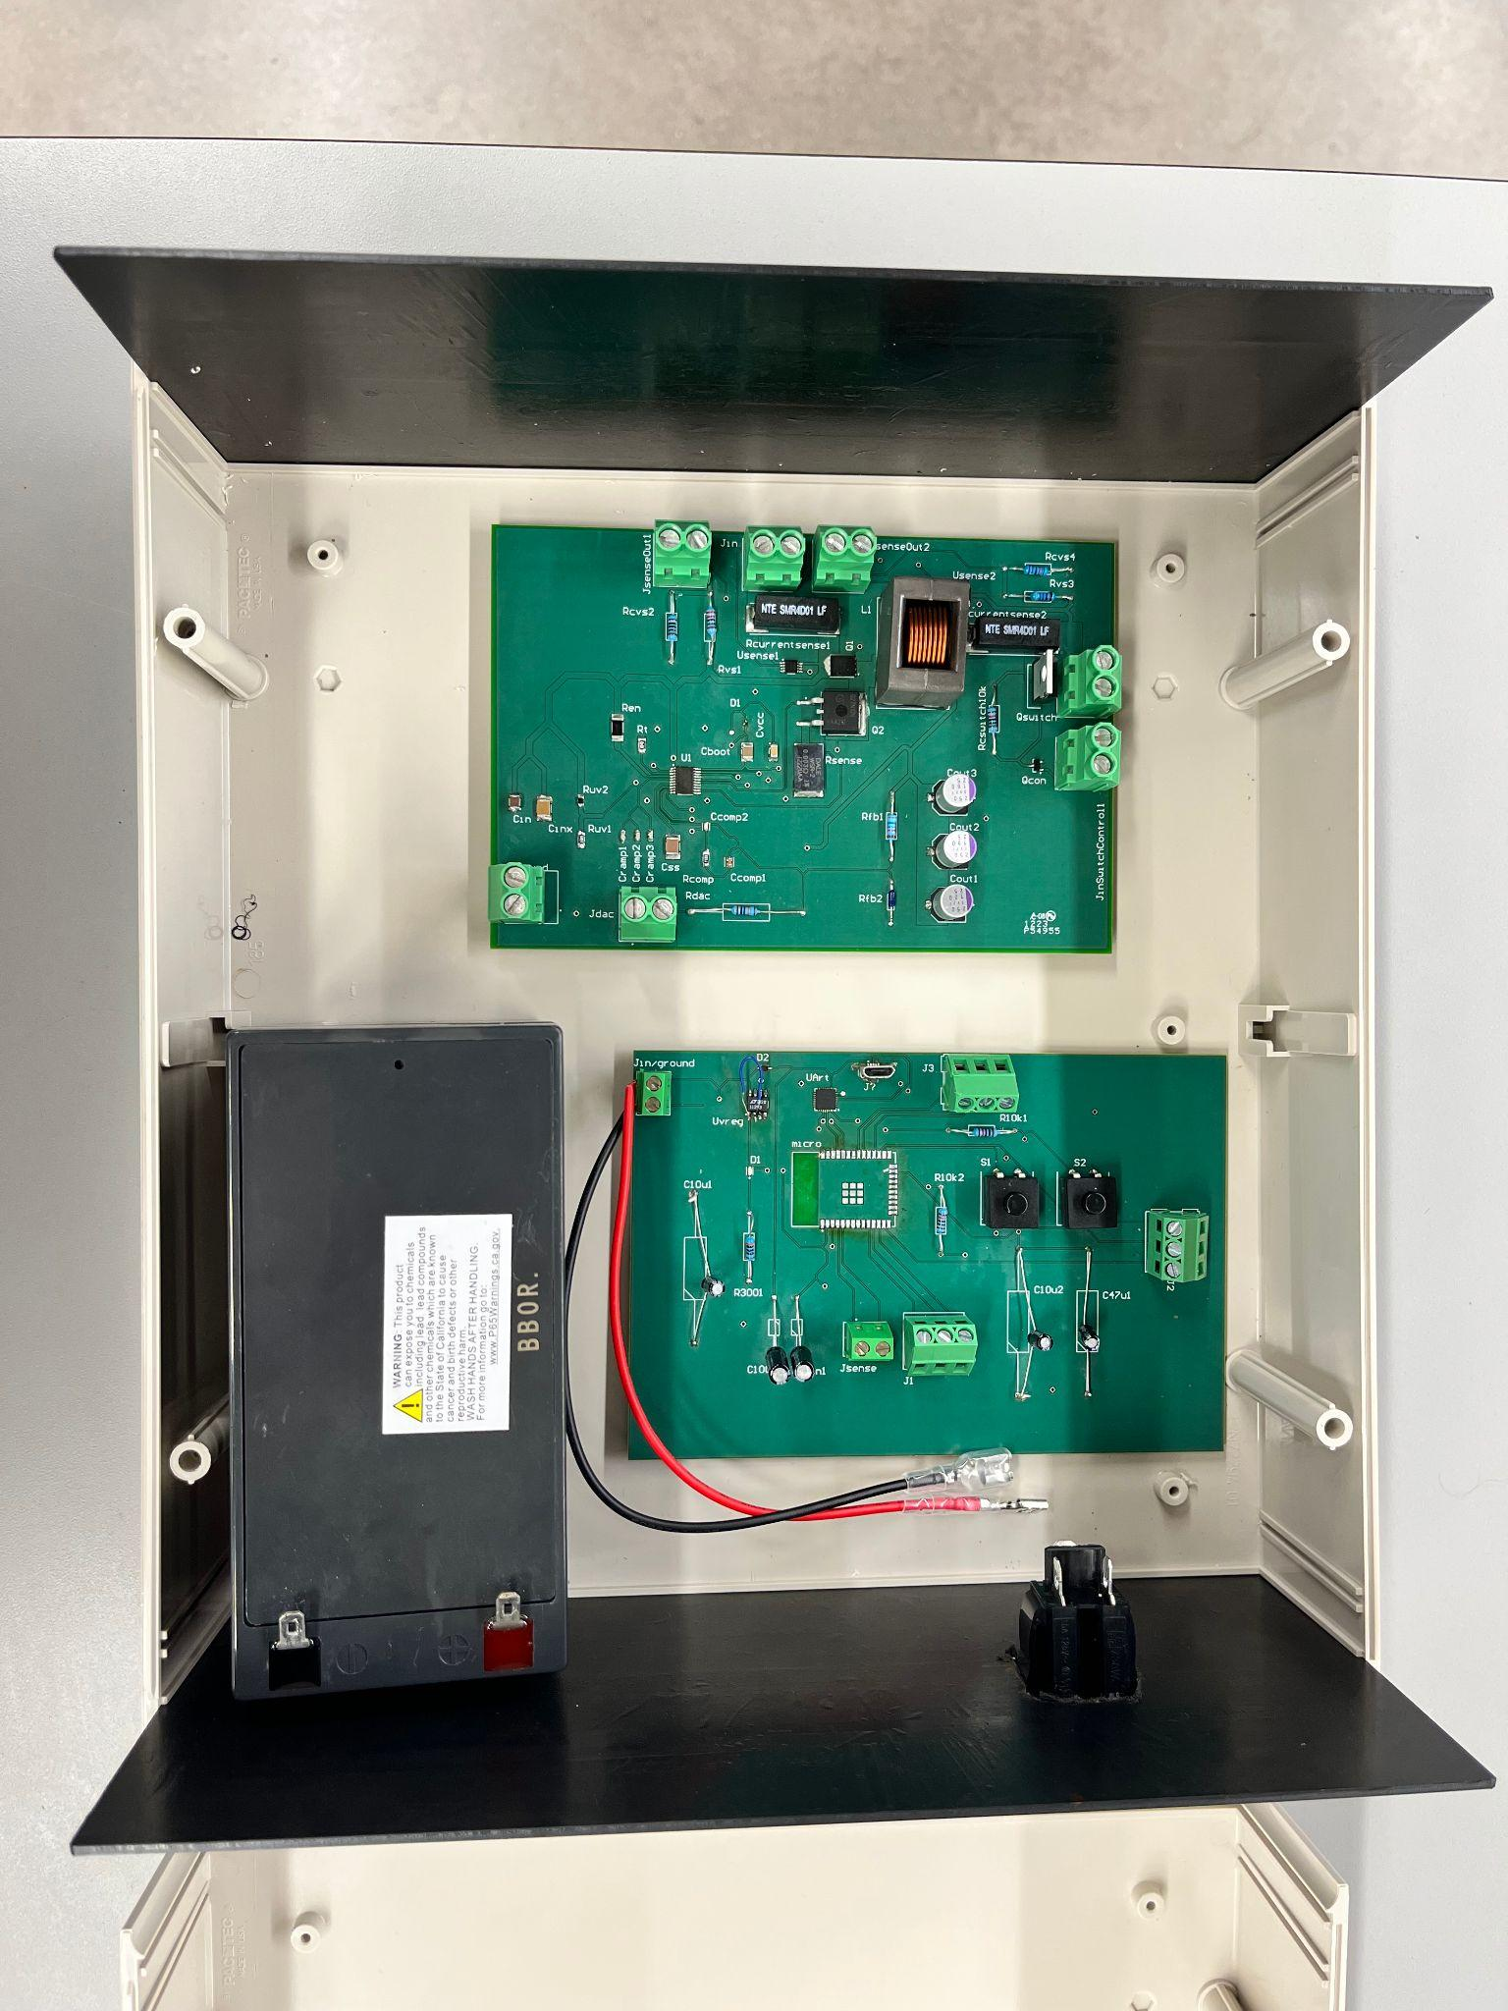
Integrated Project Diagram
Top level
Battery Sensor
Solar Panel
DC-AC
Bottom level
Microcontroller
Output ports
DC-DC
Battery

Slide 4
Max Power Point Tracking
and Switches/Sensors Subsystem
Lauren Lugo

Slide 5
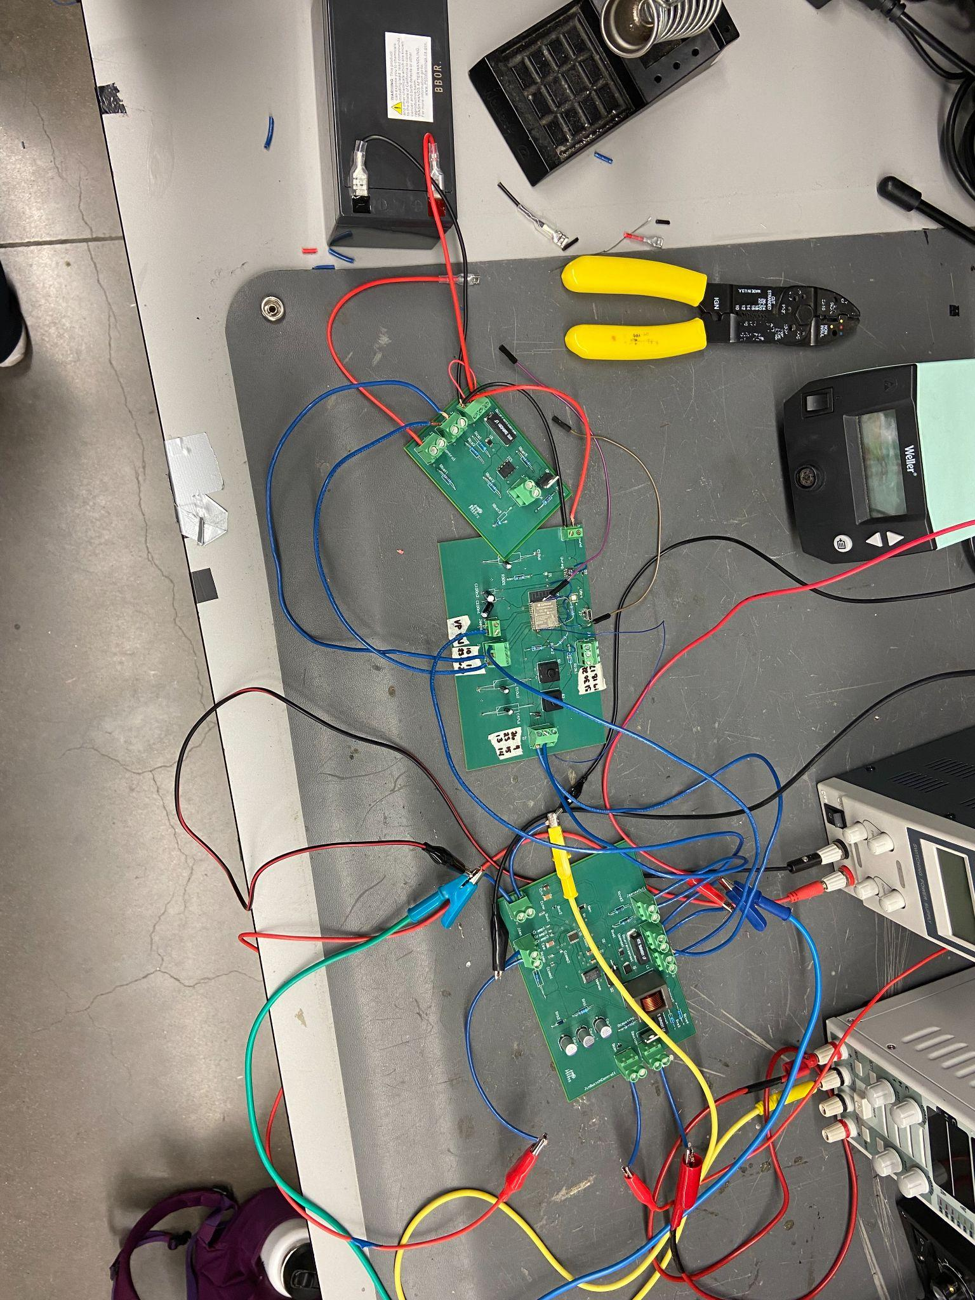
Subsystem Overview
Design Switches and Sensors to read voltage and current values.
Code the ESP32 to regulate the switch system and Max Power Point Tracking
Design the ESP32 PCB board
Send data to realtime Database

Slide 6
Major Challenges and Solutions
Challenges:
Flashing the ESP32
Connecting to the Tamu IoT
Delays due to parts not being compatible with other systems
Solutions:
Took off the UART and rerouted power
Researched and created a function to connect
Op Amp and voltage regulator were changed to different parts.

Slide 7
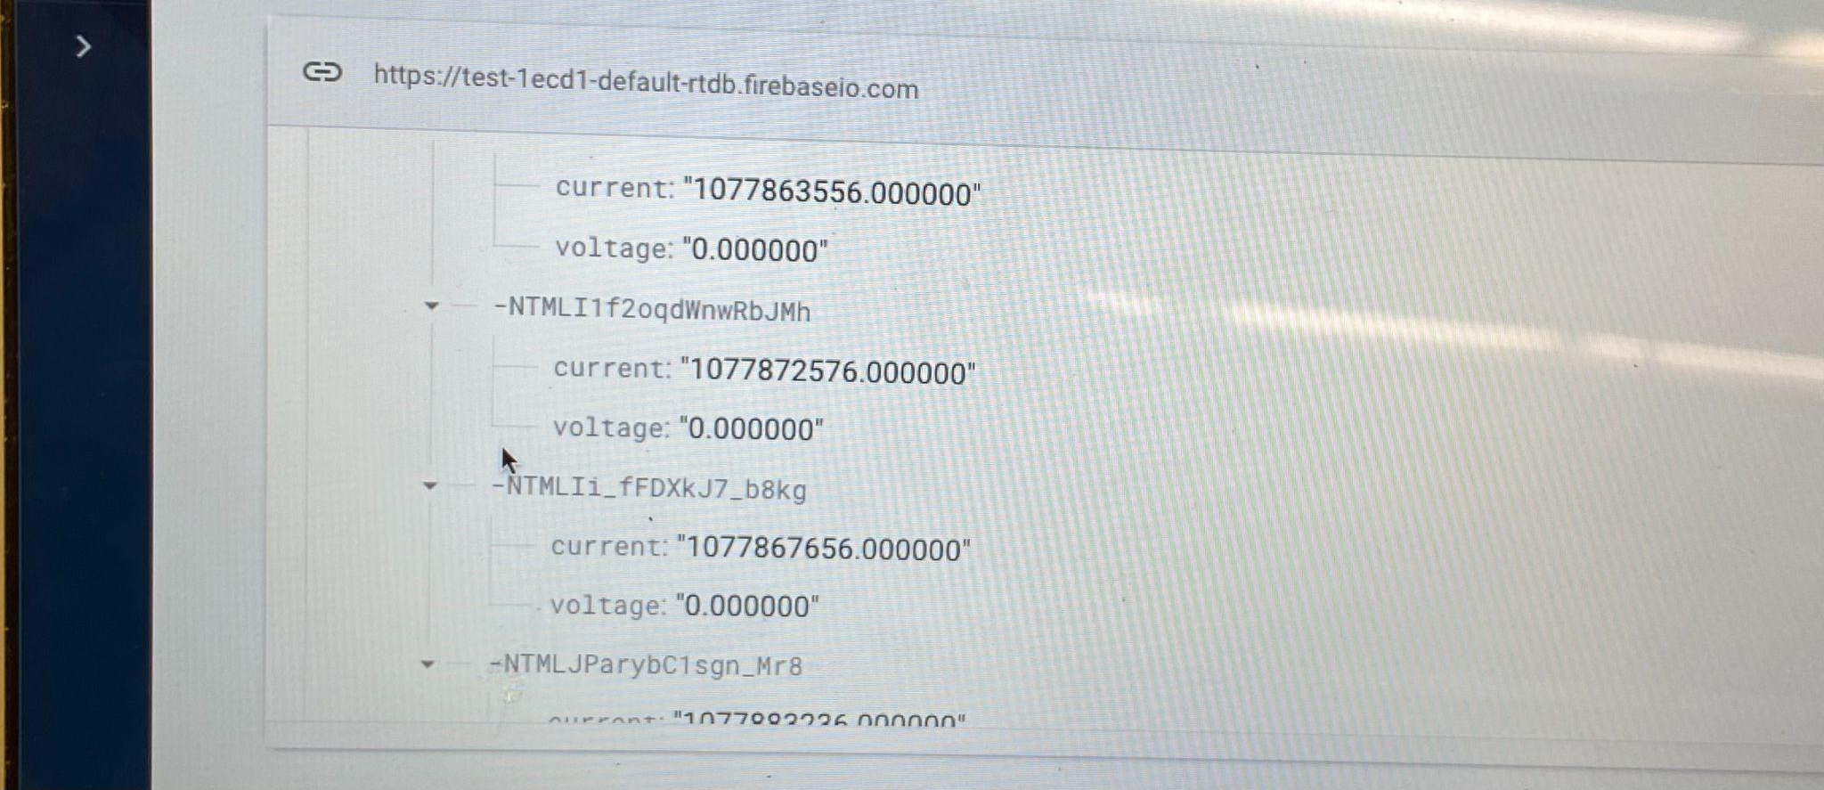
Subsystem Results
Switches and Sensors responding properly with ESP32 | Yes
Full System Shut Down when not enough power is being supplied | Yes
Max Power Point Tracking | No
Sending data to the Real Time Database | No

Slide 8
DC-DC Converter Subsystem
Tarik Dawson

Slide 9
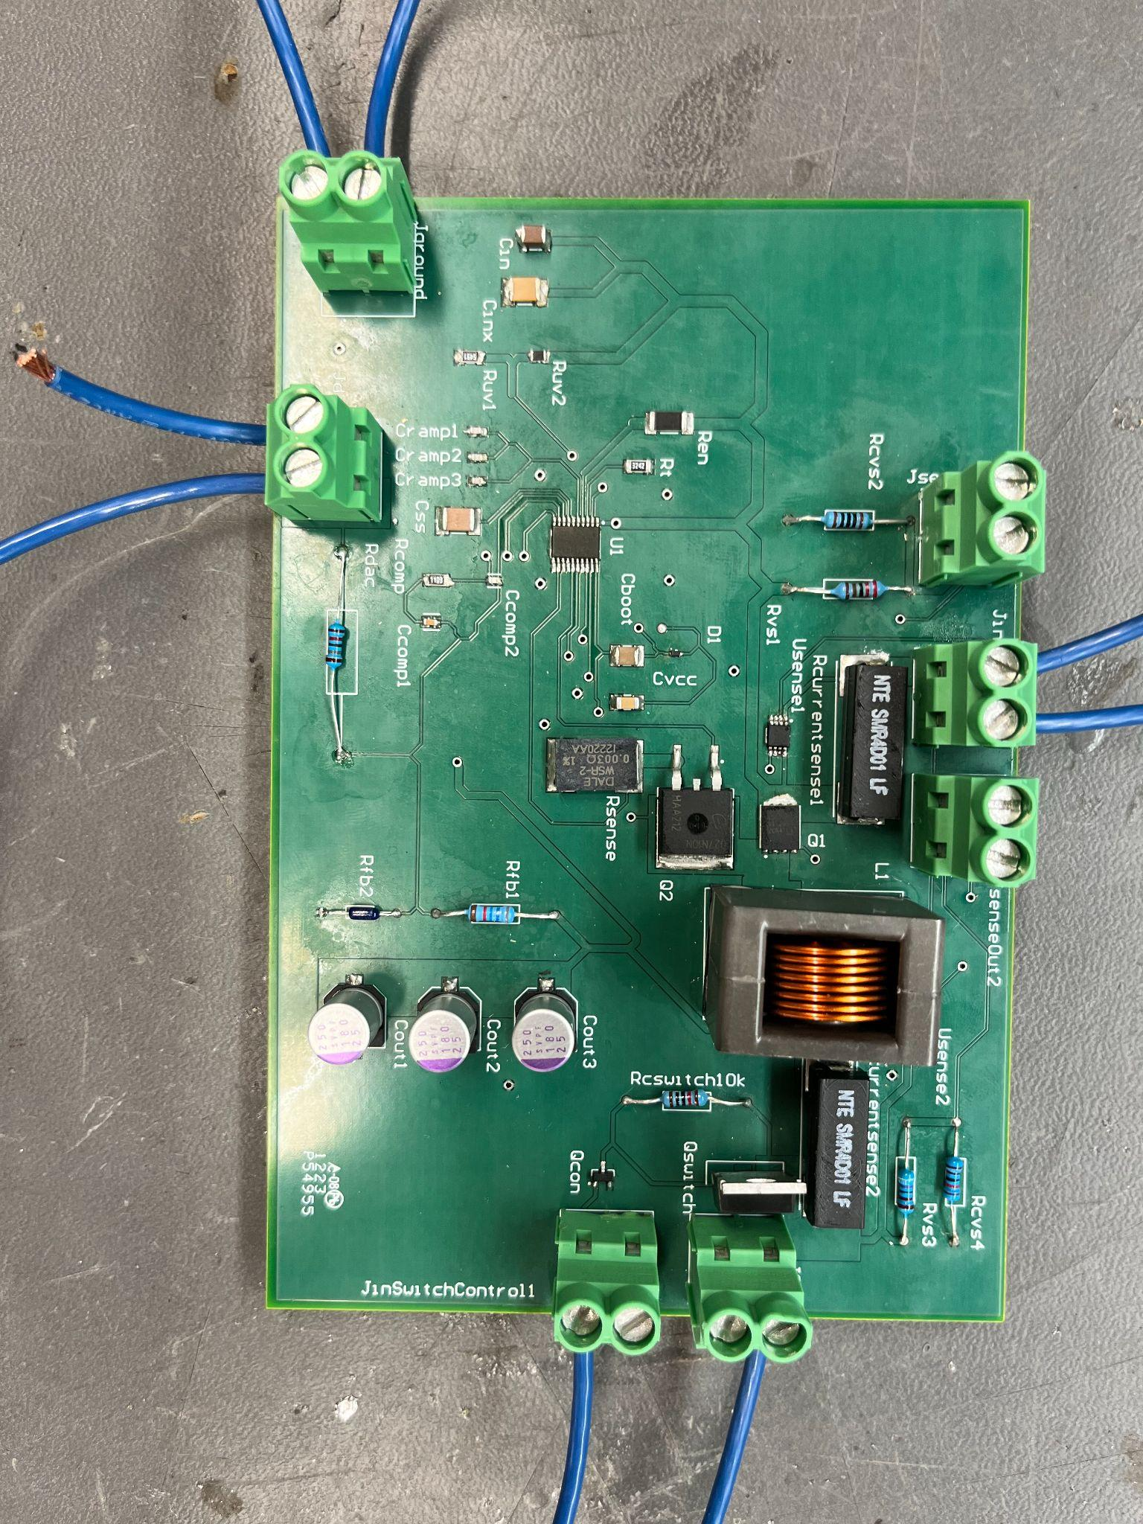
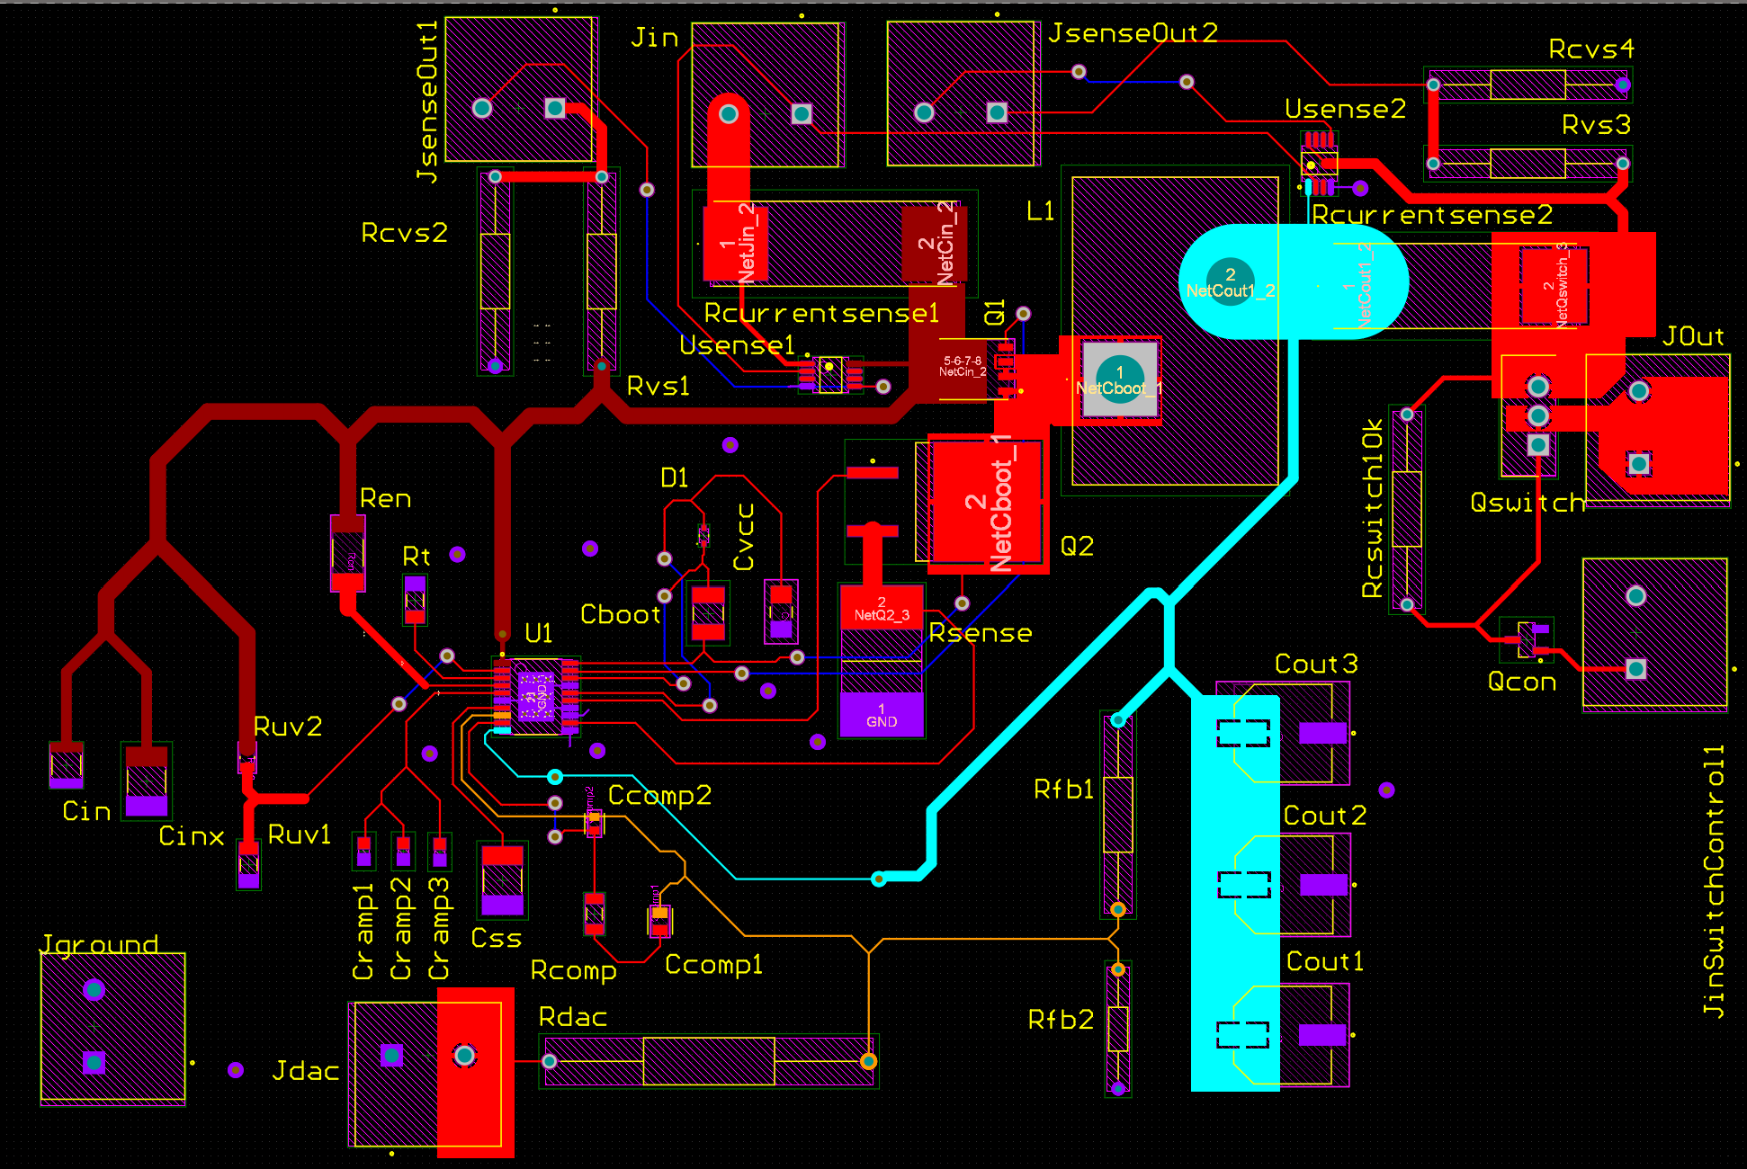
Subsystem Overview
8
Current/Voltage sensor
Powers system and load via solar panel
Able to switch on and off depending on solar power via microcontroller
Gives sensor data to microcontroller
12V
0-10A
18V-60V
0-5A
DC-DC Converter
Switch
Current/Voltage sensor

Slide 10
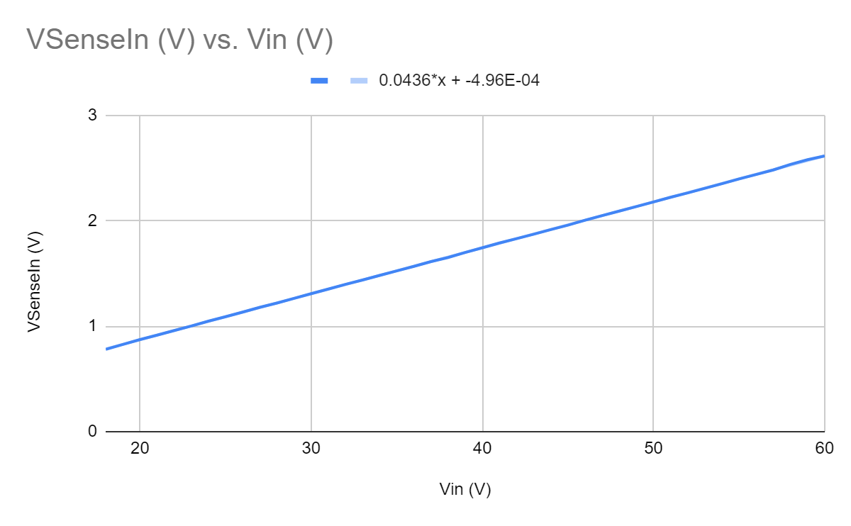
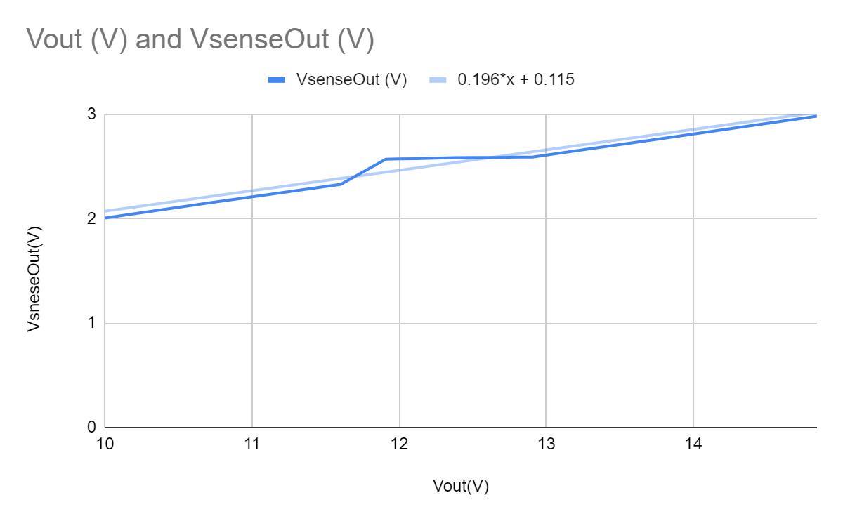
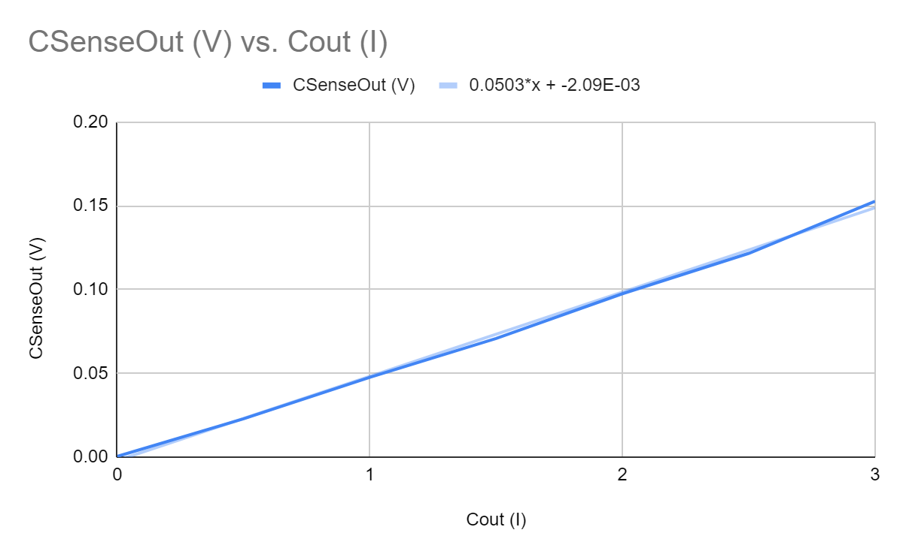
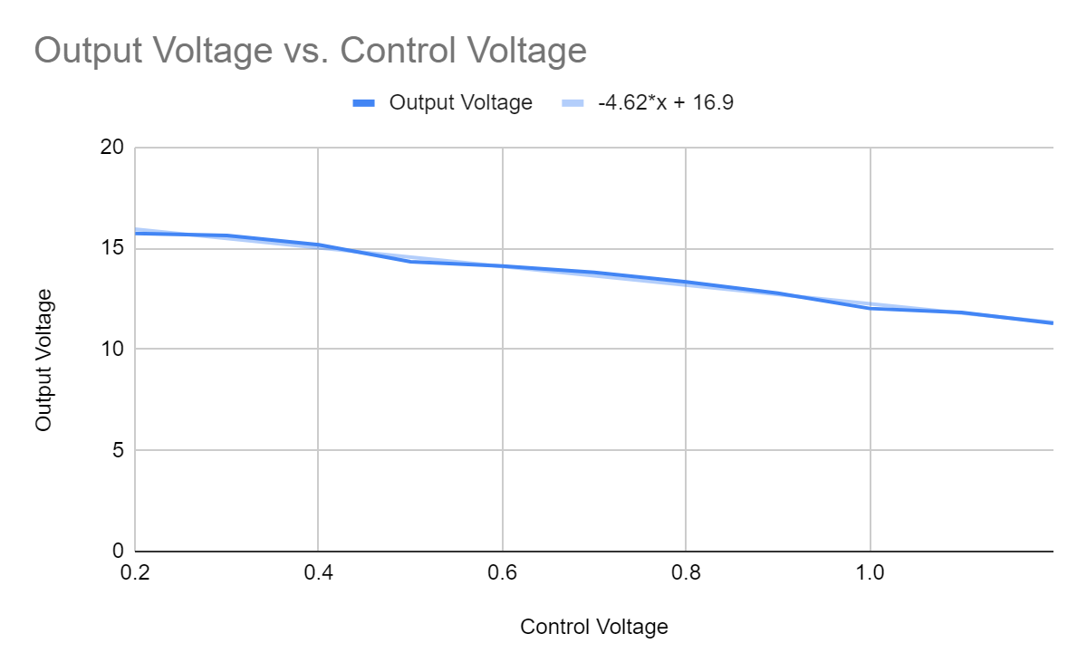
DC-DC Subsystem Specifications
Specification | Min | Max | Nominal
Solar Input Voltage Sensor | 0V | 2.6147V | N/A
Solar Input Current Sensor | 0V | 0.2515V | N/A
Output Voltage sensor | 0V | 2.966V | 2.5715V
Output Current Sensor | 0V | 0.502V | N/A
DC Output (V) uncontrolled | 8V | 15V | 12V
DC Output (V) controlled | 11.5 | 12.4 | 12V

Slide 11
DC-DC Challenges and Solutions
Challenges:
Circuit could not be simulated or breadboarded
Learning Altium
Original switch was a low side switch and wouldn’t function correctly on DC-DC board
Control not functioning correctly early on
Ensuring sensor voltage would not burn microcontroller board.
Solutions:
Design PCB as best as possible
Research and many, many questions.
Changed to a high side switch
Further research into how voltage control works.
High gain current sense opamp was replaced with a low gain op amp

Slide 12
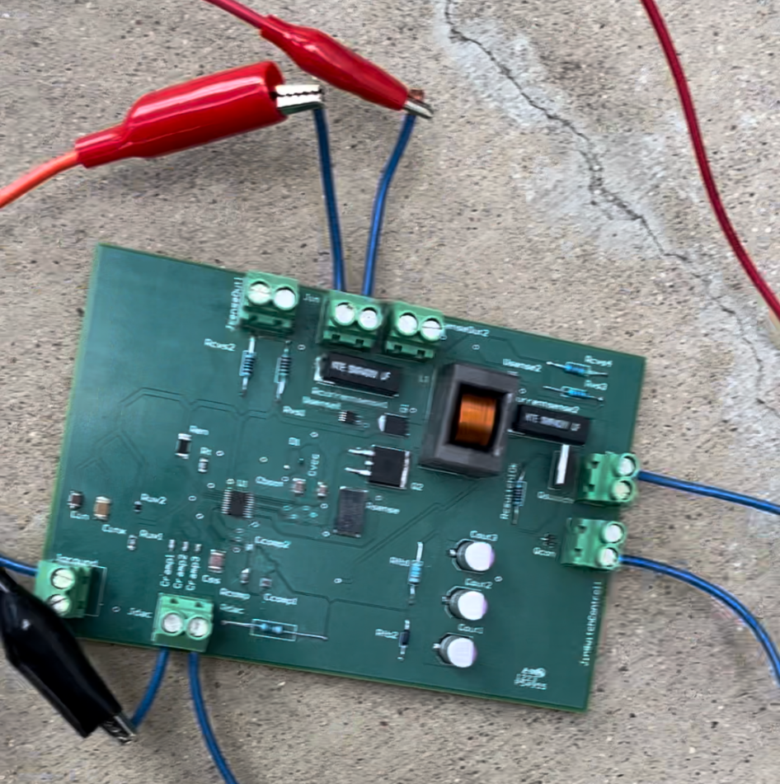
Subsystem Results
Result | Met
Subsystem switches off via microcontroller | Yes, system shuts off via microcontroller signal of 3.3V
Subsystem senses input/output voltage/current | Yes, provides microcontroller 0-3.3V signals that represent the voltage and current
Output voltage is controllable via Microcontroller | Yes, Voltage output changes depending on microcontroller signal.
Provides consistent power to whole system | Yes, 12V supplied up to 5A

Slide 13
DC-AC Inverter Subsystem
Clement Ong

Slide 14
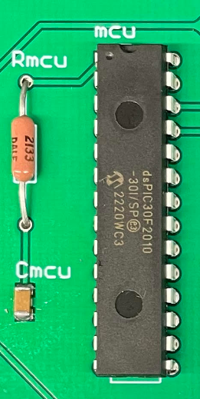
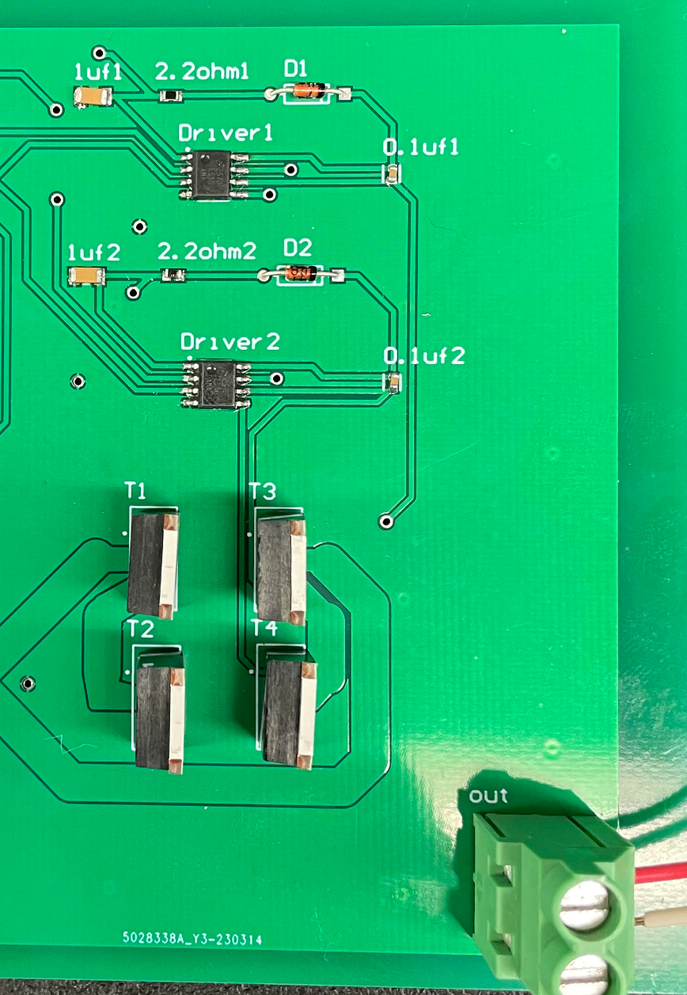
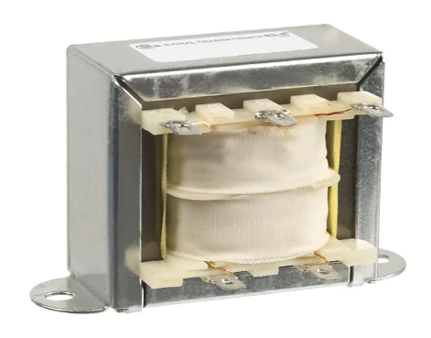
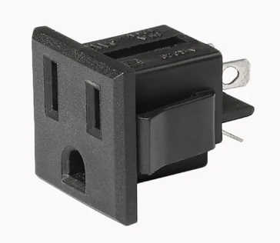
Subsystem Overview
MCU - PWM
H-Bridge
Step-Up Transformer
12V to 115V
AC Outlet
PWM Freq - 25KHz
PWm Period - 40us
Inverting H-Bridge
115VAC - 60Hz

Slide 15
DC-AC Challenges and Solutions
Challenges:
Coding PWM to produce correct output
No output from MOSFET driver, causing H-bridge malfunction
Smoking MOSFET driver
Significant power loss when connected to transformer
Solutions:
Learn datasheet, and use trial and error to obtain correct output frequency
Calculate/add bootstrap capacitor, bootstrap resistor, and bootstrap diode
Implement deadband gap
Increase deadband gap accordingly

Slide 16
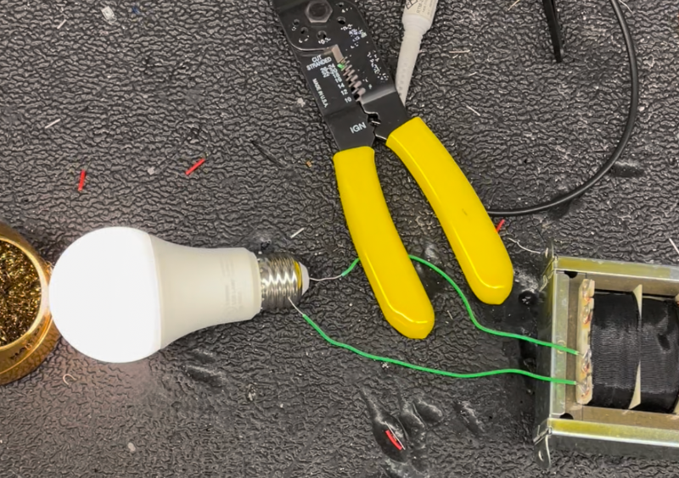
Subsystem Results
Specification (Input: 12V, 1A) | Result
Output frequency (Hz) | 60.156
Output AC voltage without transformer (V) | 10.415
Output AC voltage with transformer (V) | 108.78
Output AC current with transformer (A) | 0.0745
Output power (W) | 8.104

Slide 17
Website Application and Android Application
Nathan Gil

Slide 18

Subsystem Overview
Website and Android Application Features
Login Page for Authentication Users
Allows the User to logout and will log them out after 1 hour
Provides the User with Ability to Connect to a Unique ESP-32 Mac Address
Provides Solar Panel Power, Voltage, and Current data
Provides Battery Discharge and Charge wattage
Provides dynamic Current and Voltage going through the system from Solar Panel
Provides Battery Level and when Battery is Charging or Discharging
New: AI Weather Tracking (RapidAI) showing location, temperature (current, min, max), wind, and humidity (should change to rain/no rain)
Goal: Have a user interface (UI) that allows the user to track independent solar panel data from a website or android phone for power optimization and maintenance.
Website / Android App created with Angular JS with the help of Ionic View
The backend Database is Firebase
Receives data from ESP-32 on Solar System

Slide 19
Major Challenges and Solutions
Challenges:
Learning how to create an Android Application
Implementing Charts
Reproducing ESP32 environment on local computer (lost 2 weeks)
Flashing ESP32 / Connecting to Home Internet
Learning how to send data to Firebase using ESP32
Figuring out a good Backend Database Structure for Firebase data
Solutions:
Learned Ionic View (allows user to code website and app at the same time)
Used chart package and with big learning curve
Had to research and test different solutions involving
ordering a new ESP32
Downloading a new Windows Driver
Had to research during integration stage which delayed integration
Created a “flat” tree design, lowest level of child nodes is 3

Slide 20
Subsystem Results
ESP32 built on local machine, connecting to wifi, and sending data to Firebase | Yes
Authentication Page showing full errors (Wrong password, Username, not a valid User, etc.) | Yes
Front End application Sending / Receiving Data from Firebase Backend | Yes
Backend Database Receiving Data from ESP32 | Yes
Front-end Database Receiving Data from ESP32 | Yes
All stylistic components are dynamic depending on screen size (chart) | No
Full integration from ESP32 -> Backend Database -> Front End UI Completed | No

Slide 21
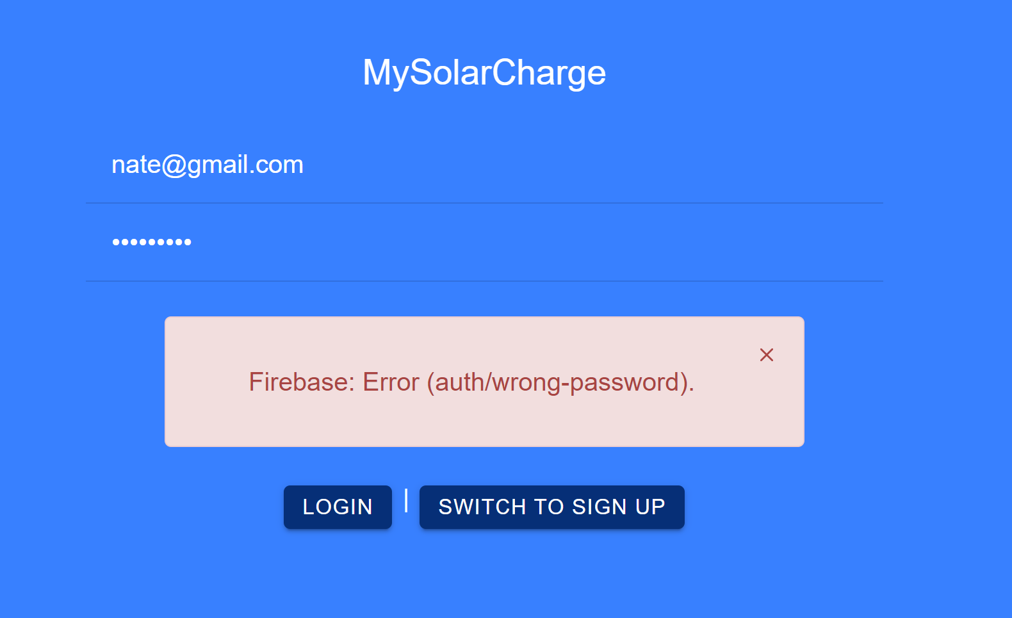
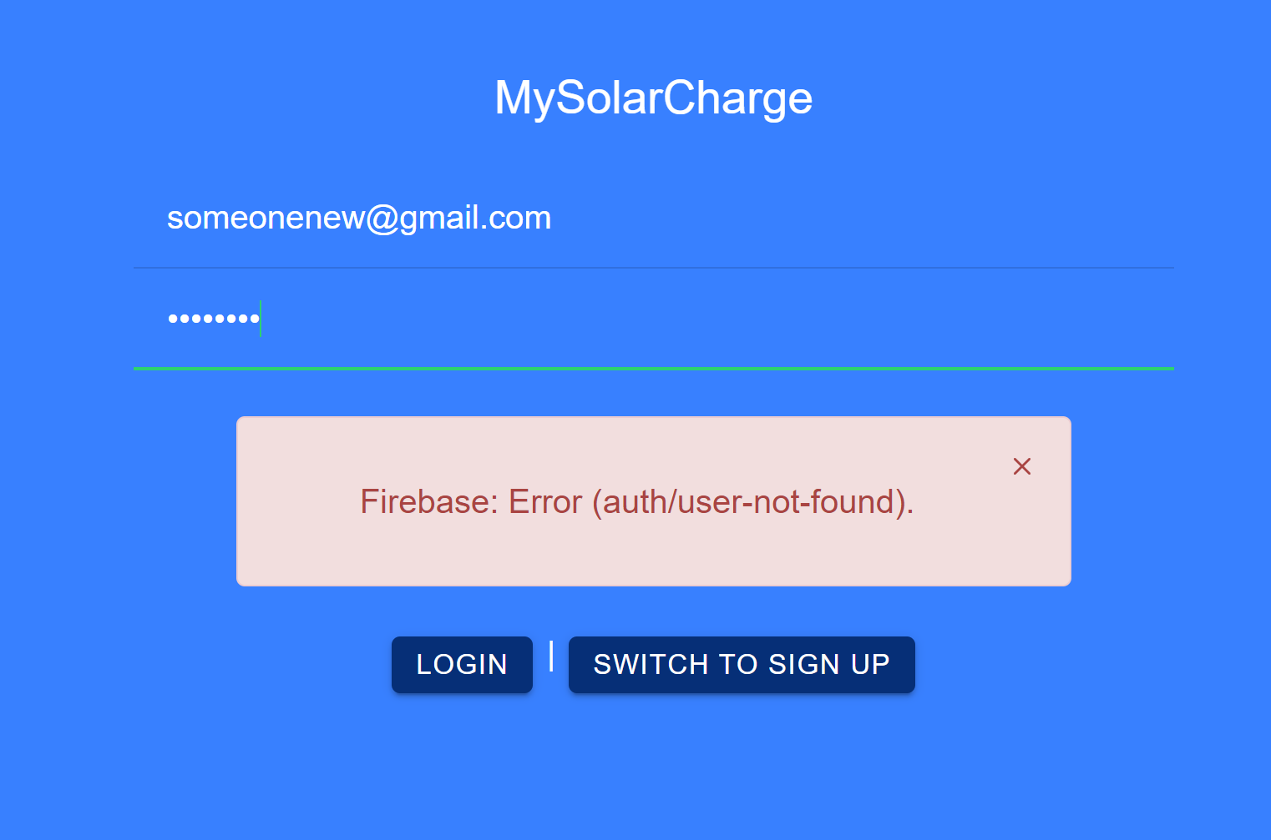
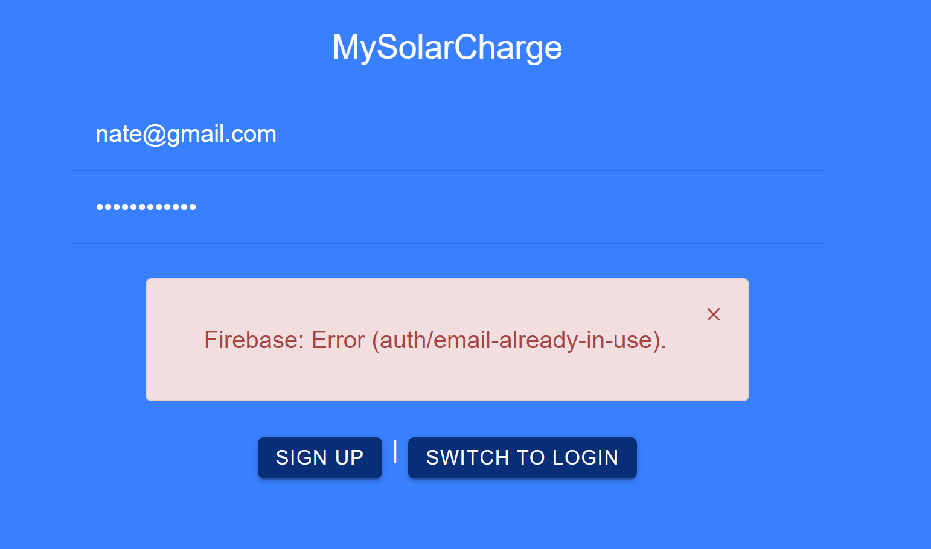
Authentication Results
Wrong Password Error
User Not Found Error
User Already Created Error

Slide 22
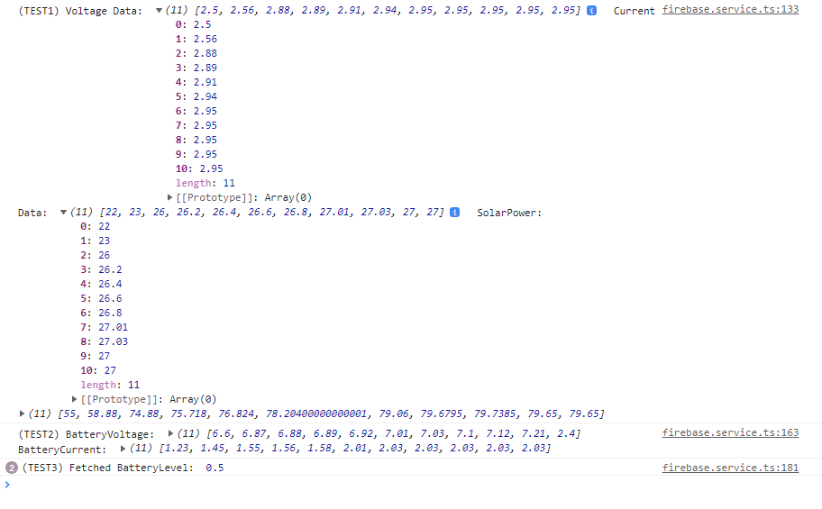
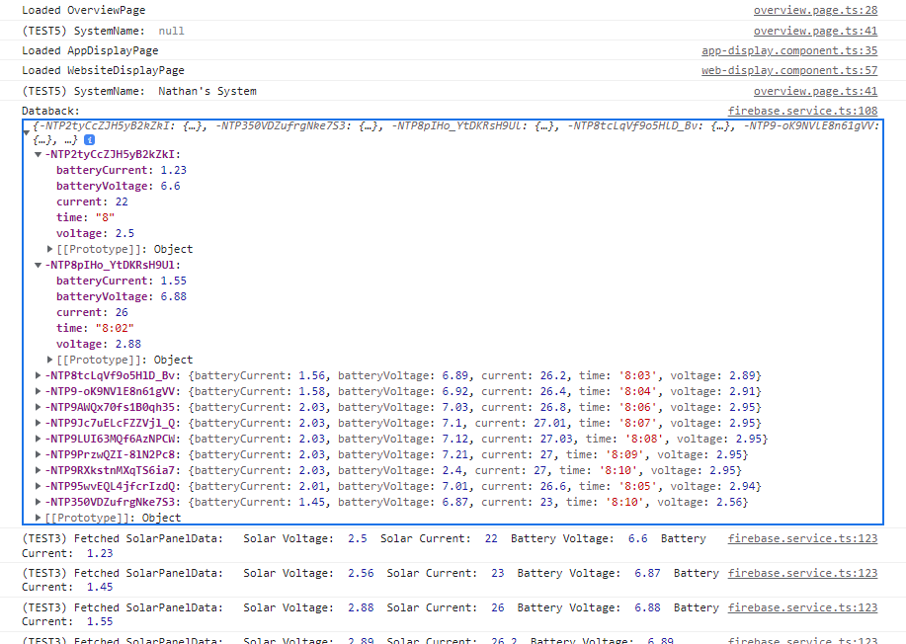
Validation
Front-end Receives Solar Panel and Battery Current / Voltage values
Front-end Receives System Name from Backend

Slide 23
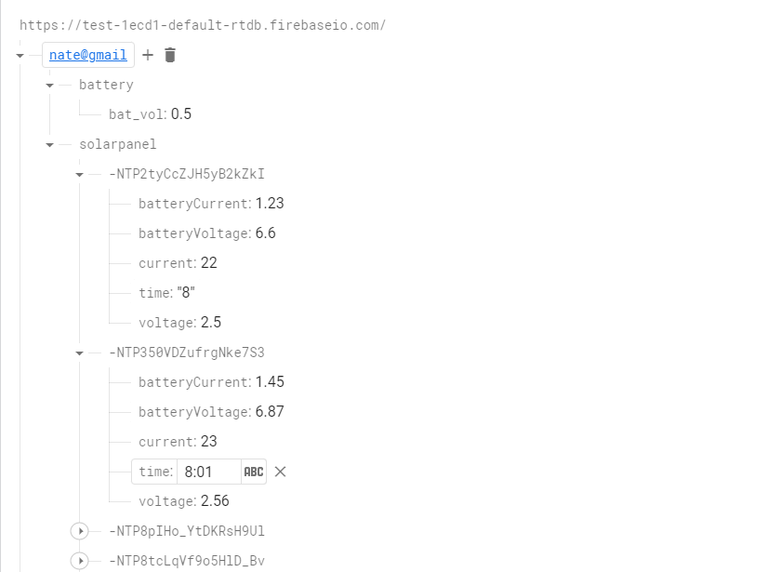
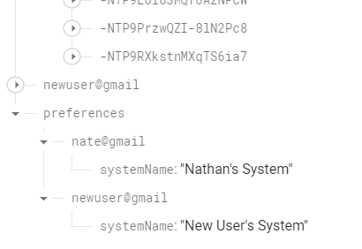
Validation
Back-End Able to be written to by Front end for System Name set by User
Back-End able to receive data from Front-end and ESP32

Slide 24
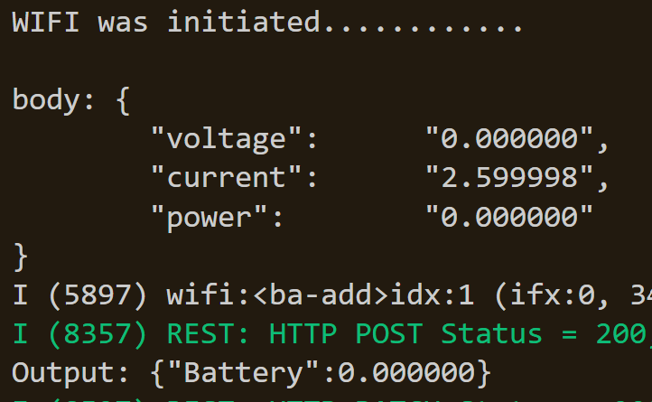
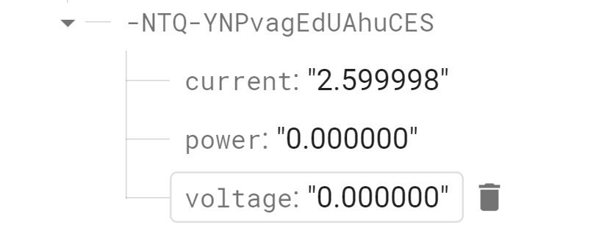
Validation
ESP-32 JSON Output to Backend with 200 good signal
Backend Database Receiving the Data (testdata not connected to system)

Slide 25
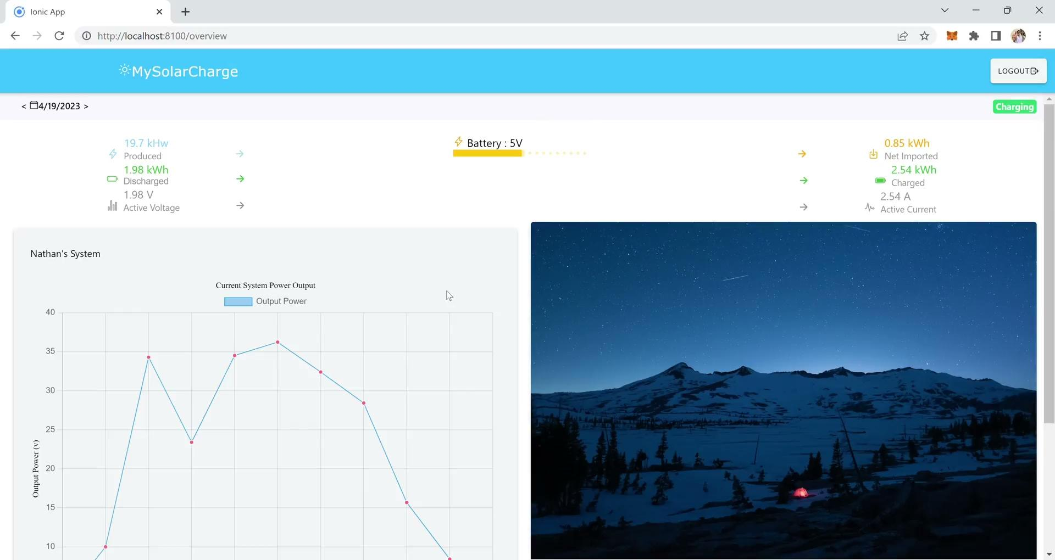
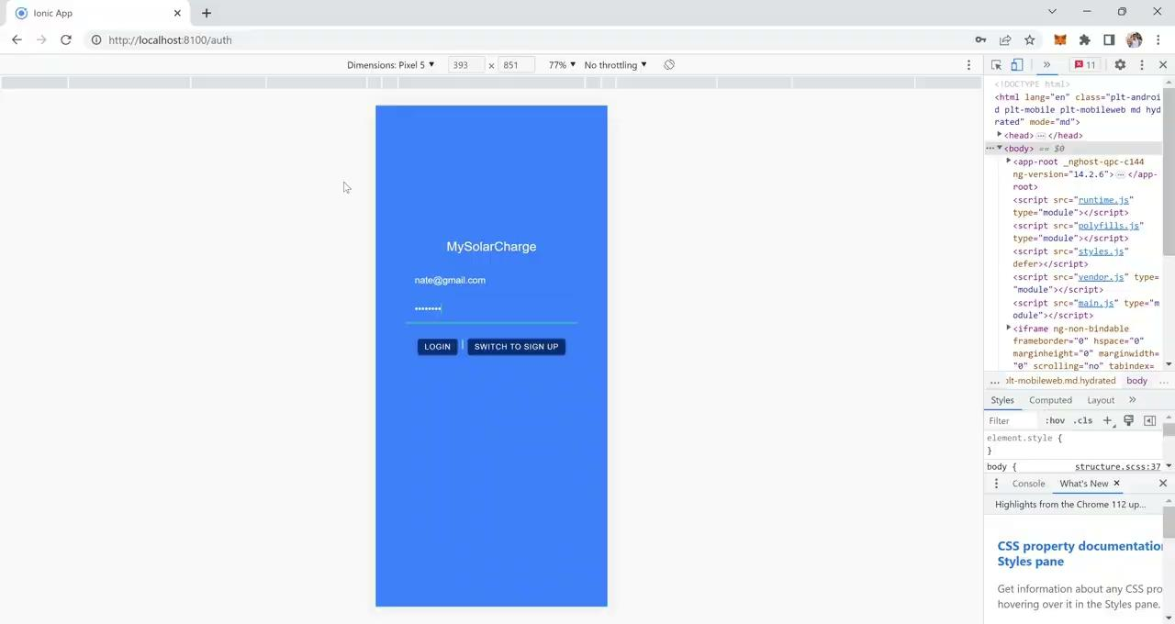
Website and Android Application UI
*Android Application to be put on Android this weekend before demo*

Slide 26
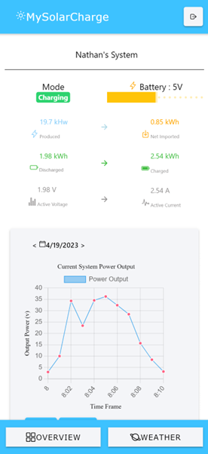
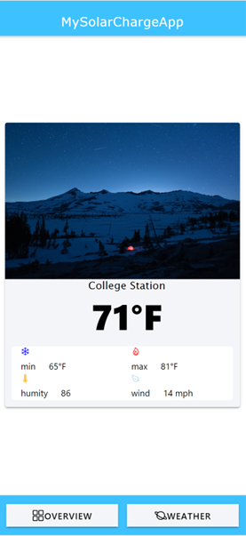
Website and Android Application UI
*Android Application to be put on Android this weekend before demo*

Slide 27
Integrated System Results
Working system with Application, Microcontroller/Switches/Sensors and DC-DC Converter
ESP32 sends data to backend database which is received by Website and Android Application

Slide 28
Conclusion
Difficulties in final integration
Getting accurate feedback from the ESP32 to the realtime database
Only partial system testing was conducted
Application, Microcontroller/Switches/Sensors, DC-DC converter
Limited testing with solar panel
System Deliverables that were met
Full system shut down
Switch/sensor system working
Connected to realtime database
Solar through power (DC)
AC output
Current Status
Cleaning up code for final demo
Replacing current sensor on DC-DC board
Testing inverter with higher current
Full system tests

Slide 29
Thank You!
Questions?

